Slide 1
DATA ANALYTICS CAPSTONE PROJECT
METROCAR
ANALYSIS

Slide 2
OBJECTIVE
To analyze Metrocar’s operational and customer data to generate data-driven insights into user behavior, ride activity, driver’s performance, and financial outcomes that will improve efficiency, and customer satisfaction.

Slide 3
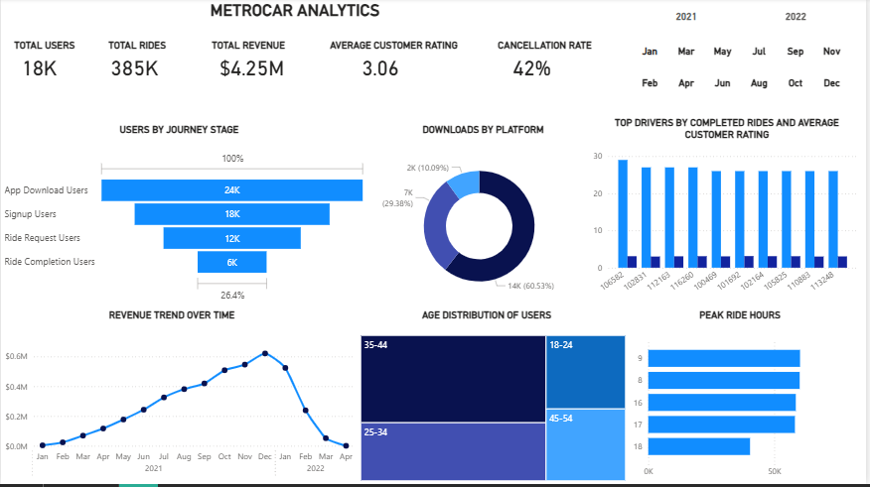
Analysis overview
Metrocar recorded:
  Total users 18K
  Total rides 385K
  Total revenue $4.25M
  Average customer rating 3.06
  Ride cancellation rate 42%
Ride demand is strongest during 8 AM, 9 AM, 4 PM, and 5 PM, indicating peak commuting hours.
Revenue showed a steady upward trend throughout 2021, peaking around December before declining sharply in early 2022.
IOS users dominate platform downloads, representing over 60% of total app downloads.
Users aged 35–44 form the largest customer segment.
There is significant user drop-off between app signup and ride request stages, highlighting conversion challenges.
Cancellation rate of 42% is high and negatively impacts customer experience and revenue.

Slide 4
Ride demand
Peak Ride Hours are 9, 8, 16,17,18 in a descending order and 24 Hour format.
The highest ride request period occurs at 9 AM.
The peak ride hours are 8am-9am and 4pm-6pm, these hours align with business resumption and closing hours.
Metrocar experiences demand surges during early and closing business hours with significant difference in the supply of drivers ranging at 13k-15.6k, therefore price surges should be applied at these hours to maximize profit.
Drivers should also be increased to meet demand at these hours

Slide 5
REVENUE TREND OVER TIME
Revenue steadily increased across 2021.
Revenue peaked around December 2021 and a significant decline occurred in early 2022.
Revenue experienced year-end ride demand in 2021 possibly from festivities and a drastic drop likely from reduced activity or operational issues in 2022.

Slide 6
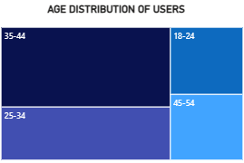
USER PLATFORM PREFERENCE AND AGE DISTRIBUTION
IOS contributes approximately 60%+ of app downloads, Android contributes roughly 30% and Web contributes the least.
Metrocar users strongly prefer IOS devices.
In light of these, IOS-targeted marketing campaigns, IOS app optimization and updates should be prioritized while maintaining Android quality to retain premium users.
35–44 years = largest user group
Followed by: 25–34 years, 18–24 years and 45–54years presenting as the smallest segment.
Metrocar’s strongest customer base seems to consist of working professionals and middle-income earners.

Slide 7
Driver Performance
Drivers were analyzed based on:
Number of completed rides & Average customer ratings
Top Drivers by completed ride volumes had lesser customer ratings with ties between drivers who had a total f 27 rides.
Driver_id 106582(CR - 29 rides, AR – 3.09), followed by three drivers with Driver_ids:
102831(CR- 27, AR – 3.00),
112163(CR -27, AR – 3.07),
116260(CR – 27, AR – 3.09).
To break tie, Driver_ids with 3.09 and 3.07 make top three with Driver_id 106582.
Average customer rating at 3.06 indicates moderate satisfaction, it is imperative that drivers performance be monitored as high-performing drivers contribute significantly to operational efficiency and customer satisfaction.
NOTE: CR – Completed Rides AR – Average Customer Rating

Slide 8
STAGES OF USER JOURNEY
1. App Downloads(23,608) → Signups(17,623)
(5,985)
2. Signups(17,623) → Ride Requests(12,406)
(5,212)
3. Ride Requests(12 ,406) → Ride Completions(6,233)
(6173)
Metrocar looses the most users at the ride completion stage with a difference of 6,173 dropped from ride request(12,406) to ride completion(6,233).

Slide 9
RECOMMENDATIONS
User Behavior:
  Onboarding and ride booking process should be simplified, discounts should be offered for first time-users, customer retention campaigns should be launched, referral rewards introduced and app performance & reliability be improved.
Ride Activity
  Ride cancellation rate rides should be reduced by matching riders with nearby drivers faster, excessive driver cancellations be penalized and increase driver availability during peak periods.
Financial outcomes
  To increase revenue causes of revenue decline in 2022 should be investigated, price surge be applied during peak hours(8a-9am and 4pm-6pm), marketing should focus on high-performing age groups and ride completion rates improved.
Customer Satisfaction and Driver’s Performance:
  Drivers should undergo better driver and customer service trainings. Service ratings and feedback should be monitored and not just be recorded to identify poor performing drivers, incentives should be offered to drivers for peak-hour participation.

Slide 10

CONCLUSION
Metrocar demonstrates strong growth potential with high ride activity and solid revenue generation. However, the company faces operational challenges, particularly high cancellation rates and user drop-offs in the customer journey. Addressing these issues through targeted operational improvements, customer retention strategies, and demand optimization can significantly improve profitability and customer satisfaction.

Slide 11
Thank you
ABAMBA HANNAH .c.
Hannahabamba@gmail.com
http://linkedin.com/in/hannah-a-95a7a3208

